Slide 1
Patterns and Algebraic rules

Slide 2



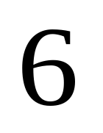
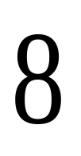


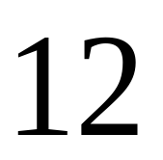

Rule recap
Remember: We look for a number pattern in a sequence:
,
,
,
The rule is add 2 to the previous term.
The rule is add 4 to the previous term.
,
,
,
Hand out worksheet 1

Slide 3





Using rules in shape patterns.
Remember, when we have a shape pattern it helps if we draw a table:
Term | 1 | 2 | 3 | 4 | 5
No of sides | 4 | 8 | 12 | 16 | 20

Slide 4
Writing our rule as a formula
The rule is add 4 to the previous term.
Is there another way to get from the term number to the number of sides?
What other mathematical sequence matches 4,8,12,16,20?
The multiples of 4!!
If we multiply the term number by 4 we get the number of sides!!

Slide 5
The formula
The number of sides = 4 × the term number.

Slide 6
Using algebra in our formula
To use algebra we must follow some rules:
Always put what you are trying to find first.
Put the number you multiply by before a letter.

Slide 7
The change to algebra.
Lets look at our formula again:
The number of tiles = 4 × the term number.
It would be useful to simplify the formula: Letters (for our variables) and numbers.
The number of tiles can be "t"
The term number can be "n"

Slide 8

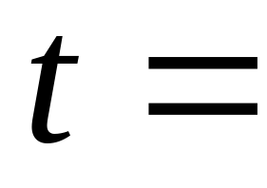


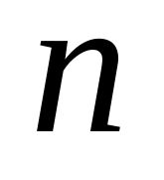
The algebraic formula
There is one more thing we need to do:
We never use a multiplication sign in algebraic formulas.
Worksheet 1 ends

Slide 9
Two stage formulas
Some rules are not as straight forward and you may have to use two stages.
This means that after multiplying your term number, you may need to add or subtract a number to reach your answer.
Hand out worksheet 2

Slide 10





The pattern

Slide 11

Next is
13

Slide 12

Pattern table
Term | 1 | 2 | 3 | 4 | 5
No of Tiles | 3 | 5 | 7 | 9 | 11

Slide 13
The rule
Remember we noticed that the sequence pattern matched the multiples of a number?
We can use that every time.
Our sequence matches the multiples of 2 so lets see how that works:

Slide 14
The first stage
Term | 1 | 2 | 3 | 4 | 5
No of Tiles | 3 | 5 | 7 | 9 | 11
Term × 2 | 2 | 4 | 6 | 8 | 10
We are not quite there, what do we need to do to reach the
number of tiles?

Slide 15
The second stage
(n) Term | 1 | 2 | 3 | 4 | 5
No of Tiles | 3 | 5 | 7 | 9 | 11
Term ×2 | 2 | 4 | 6 | 8 | 10
Add 1 | 3 | 5 | 7 | 9 | 11
We need to add one after we have multiplied.

Slide 16
The formula
The formula is:
the number of tiles = 2 × the term number + 1
Remember to change to algebra we use letters:
the number of tiles can be "t"
the term number is always "n"

Slide 17
The algebraic formula
t = 2n + 1
Remember: no multiplication sign.
Worksheet 2 ends

Slide 18
Other two stage formulas
Find a formula for these in the same way:
1
2
3

Slide 19
Solution
Term
1
2
3
4
5
No of tiles
5
9
13
17
21
Term
×4
4
8
12
16
20
Add 1
5
9
13
17
21
Formula is: number of tiles = 4 × term number + 1
Algebraic formula is: t = 4n + 1

